Slide 1
Searching, Sorting and Greedy Algorithms
Searching, Sorting and Greedy Algorithms
SoftUni Team
Technical Trainers
Software University
https://softuni.bg

Slide 2
Have a Question?
sli.do
#Algorithms-CSharp

Slide 3
Table of Contents
Searching Algorithms
Linear Search
Binary Search
Simple Sorting Algorithms
Selection, Bubble Sort and Insertion
Advanced Sorting Algorithms
QuickSort, MergeSort
Greedy Algorithms
3
Notes:
3

Slide 4


Searching Algorithms
Linear and Binary Search

Slide 5
Search Algorithm
Search algorithm == an algorithm for finding an item with specified properties among a collection of items
Different types of searching algorithms:
For virtual search spaces
Satisfy specific mathematical equations
Try to exploit partial knowledge about a structure
For sub-structures of a given structure
A graph, a string, a finite group
Search for the min / max of a function, etc.

Slide 6
Linear Search
Linear search finds a particular value in a list
Checking every one of the elements
One at a time, in sequence
Until the desired one is found
Worst & average performance: O(n)
for each item in the list:
if that item has the desired value,
return the item's location
return nothing

Slide 7
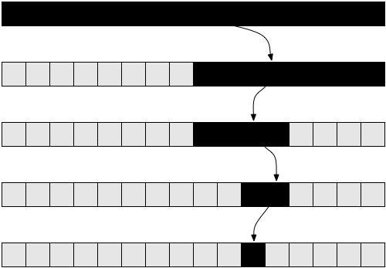
Binary Search
Binary search finds an item within a ordered data structure
At each step, compare the input with the middle element
The algorithm repeats its action to the left or right sub-structure
Average performance: O(log(n))
See the visualization

Slide 8
Binary Search (Iterative)
static int BinarySearch(int[] numbers, int searchNumber) {
var left = 0;
var right = numbers.Length - 1;
while (left <= right) {
var mid = (left + right) / 2;
if (numbers[mid] == searchNumber)
return mid;
if (searchNumber > numbers[mid])
left = mid + 1;
else
right = mid - 1;
}
return -1;
}

Slide 9

Simple Sorting Algorithms
Selection Sort and Bubble Sort

Slide 10
What is a Sorting Algorithm?
Sorting algorithm
An algorithm that rearranges elements in a list
In non-decreasing order
Elements must be comparable
More formally
The input is a sequence / list of elements
The output is an rearrangement / permutation of elements
In non-decreasing order

Slide 11

Sorting – Example
Efficient sorting algorithms are important for:
Producing human-readable output
Canonicalizing data – making data uniquely arranged
In conjunction with other algorithms, like binary searching
Example of sorting:
Unsorted list
sorting
Sorted list
10 | 3 | 7 | 3 | 4
3 | 3 | 4 | 7 | 10

Slide 12
Sorting Algorithms: Classification
Sorting algorithms are often classified by:
Computational complexity and memory usage
Worst, average and best-case behavior
Recursive / non-recursive
Stability – stable / unstable
Comparison-based sort / non-comparison based

Slide 13
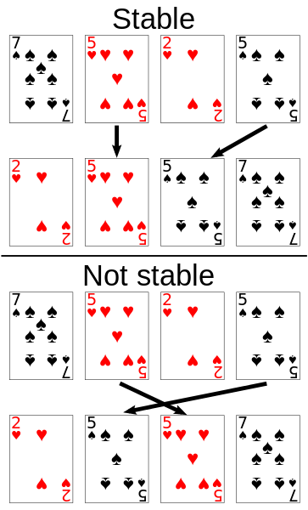
Stability of Sorting
Stable sorting algorithms
Maintain the order of equal elements
If two items compare as equal, their relative order is preserved
Unstable sorting algorithms
Rearrange the equal elements in unpredictable order
Often different elements have same key used for equality comparing

Slide 14
Selection Sort
Selection sort – simple, but inefficient algorithm
Swap the first with the min element on the right, then the second, etc.
Memory: O(1)
Time: O(n²)
Stable: No
Method: Selection

Slide 15
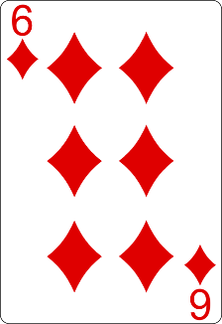
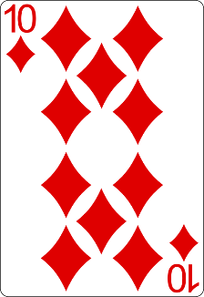
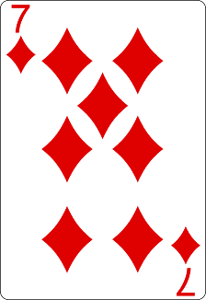
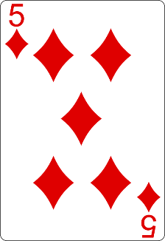
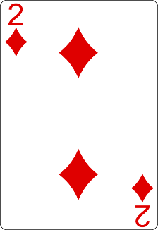
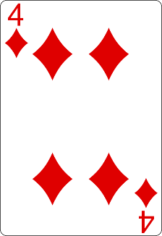
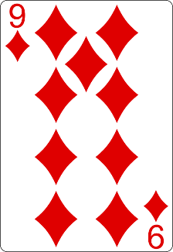
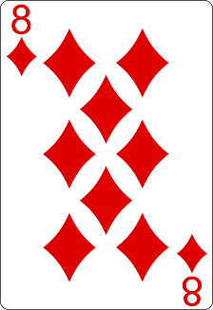
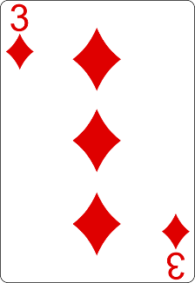
Selection Sort Visualization
Index
Min

Slide 16
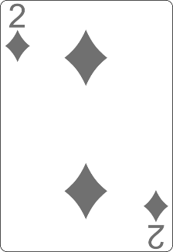
Selection Sort Visualization
Index
Min

Slide 17
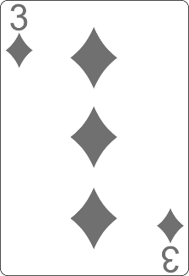
Selection Sort Visualization
Index
Min

Slide 18
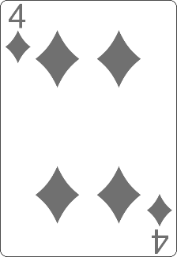
Selection Sort Visualization
Min
Index

Slide 19
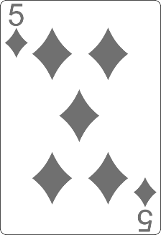
Selection Sort Visualization
Min
Index

Slide 20
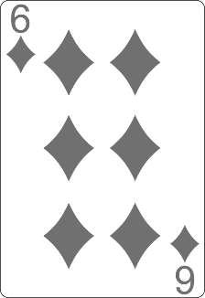
Selection Sort Visualization
Min
Index

Slide 21
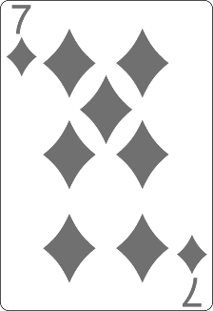
Selection Sort Visualization
Index
Min

Slide 22
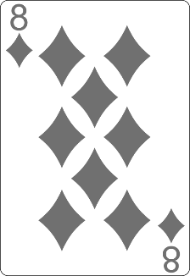
Selection Sort Visualization
Min
Index

Slide 23
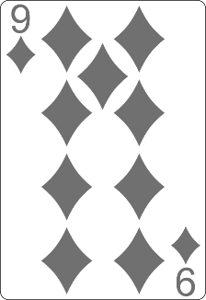
Selection Sort Visualization
Min
Index

Slide 24
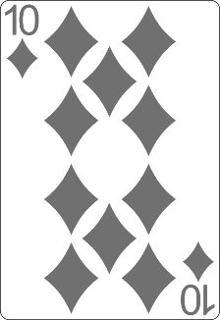
Selection Sort Visualization

Slide 25
Selection Sort Visualization

Slide 26
Selection Sort Code
for (int index = 0; index < arr.Length; index++) { var min = index; for (int curr = index + 1; curr < arr.Length; curr++) { if (arr[curr] < arr[min]) { min = curr; } } Swap(arr, index, min); }

Slide 27
Bubble Sort
Bubble sort – simple, but inefficient algorithm
Swaps to neighbor elements when not in order until sorted
Memory: O(1)
Time: O(n²)
Stable: Yes
Method: Exchanging

Slide 28
Bubble Sort Visualization
i
j

Slide 29
Bubble Sort Visualization
i
j

Slide 30
Bubble Sort Visualization
i
j

Slide 31
Bubble Sort Visualization
i
j

Slide 32
Bubble Sort Visualization
i
j

Slide 33
Bubble Sort Visualization
i
j

Slide 34
Bubble Sort Visualization
i
j

Slide 35
Bubble Sort Visualization
i
j

Slide 36
Bubble Sort Visualization
i
j

Slide 37
Bubble Sort Visualization
i
j

Slide 38
Bubble Sort Visualization
i
j

Slide 39
Bubble Sort Visualization
i
j

Slide 40
Bubble Sort Visualization
i
j

Slide 41
Bubble Sort Visualization
i
j

Slide 42
Bubble Sort Visualization
i
j

Slide 43
Bubble Sort Visualization
i
j

Slide 44
Bubble Sort Visualization
i
j

Slide 45
Bubble Sort Visualization
i
j

Slide 46
Bubble Sort Visualization
i
j

Slide 47
Bubble Sort Visualization
i
j

Slide 48
Bubble Sort Visualization
i
j

Slide 49
Bubble Sort Visualization
i
j

Slide 50
Bubble Sort Visualization
i
j

Slide 51
Bubble Sort Visualization
i
j

Slide 52
Bubble Sort Visualization
i
j

Slide 53
Bubble Sort Visualization
i
j

Slide 54
Bubble Sort Visualization
i
j

Slide 55
Bubble Sort Visualization
i
j

Slide 56
Bubble Sort Visualization
i
j

Slide 57
Bubble Sort Visualization
i
j

Slide 58
Bubble Sort Visualization
i
j

Slide 59
Bubble Sort Visualization
i
j

Slide 60
Bubble Sort Visualization
i
j

Slide 61
Bubble Sort Visualization
i
j

Slide 62
Bubble Sort Visualization
i
j

Slide 63
Bubble Sort Visualization

Slide 64
BubbleSort
var numbers = new [] {1, 3, 4, 2, 5, 6};
for (int i = 0; i < numbers.Length; i++) {
for (int j = 1; j < numbers.Length - i; j++) {
if (numbers[j - 1] > numbers[j]) {
Swap(numbers, j - 1, j);
}
}
}

Slide 65
Bubble Sort (2)
var numbers = new [] {1, 3, 4, 2, 5, 6};
var isSorted = false;
var i = 0;
while (!isSorted) {
isSorted = true;
for (int j = 1; j < numbers.Length - i; j++) {
if (numbers[j - 1] > numbers[j]) {
isSorted = false;
Swap(numbers, j - 1, j);
}
}
i += 1;
}

Slide 66
Comparison of Sorting Algorithms
Name | Best | Average | Worst | Memory | Stable | Method
Selection | n² | n² | n² | 1 | No | Selection
Bubble | n | n² | n² | 1 | Yes | Exchanging

Slide 67
Insertion Sort
Insertion Sort – simple, but inefficient algorithm
Move the first unsorted element left to its place
Memory: O(1)
Time: O(n²)
Stable: Yes
Method: Insertion

Slide 68
Insertion Sort
for (int i = 1; i < arr.Length; i++)
{
var j = i;
while (j > 0 && arr[j] < arr[j - 1])
{
Swap(arr, j, j - 1);
j--;
}

Slide 69
Comparison of Sorting Algorithms
Name | Best | Average | Worst | Memory | Stable | Method
Selection | n² | n² | n² | 1 | No | Selection
Bubble | n | n² | n² | 1 | Yes | Exchanging
Insertion | n | n² | n² | 1 | Yes | Insertion

Slide 70

Advanced Sorting Algorithms
QuickSort, MergeSort

Slide 71
Quick Sort
QuickSort – efficient sorting algorithm
Choose a pivot; move smaller elements left & larger right; sort left & right
Memory: O(log(n)) stack space (recursion)
Time: O(n²)
Stable: Depends
Method: Partitioning

Slide 72
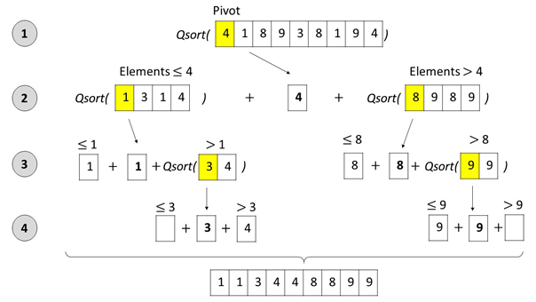
Quick Sort: Conceptual Overview

Slide 73
Quick Sort (1)
public static void QuickSortHelper(
int[] array, int startIdx, int endIdx)
{
if (startIdx >= endIdx)
return;
var pivotIdx = startIdx;
var leftIdx = startIdx + 1;
var rightIdx = endIdx;
while (leftIdx <= rightIdx) {
// TODO: Continues on the next slide
}
// TODO: Continues on slide Quick Sort (3)
}

Slide 74
Quick Sort (2)
if (array[leftIdx] > array[pivotIdx] &&
array[rightIdx] < array[pivotIdx]) {
Swap(array, leftIdx, rightIdx);
}
if (array[leftIdx] <= array[pivotIdx]) {
leftIdx += 1;
}
if (array[rightIdx] >= array[pivotIdx]) {
rightIdx -= 1;
}

Slide 75
Quick Sort (3)
Swap(array, pivotIdx, rightIdx);
var isLeftSubArraysSmaller =
rightIdx - 1 - startIdx < endIdx - (rightIdx + 1);
if (isLeftSubArraysSmaller) {
QuickSortHelper(array, startIdx, rightIdx - 1);
QuickSortHelper(array, rightIdx + 1, endIdx);
} else {
QuickSortHelper(array, rightIdx + 1, endIdx);
QuickSortHelper(array, startIdx, rightIdx - 1);
}

Slide 76
Comparison of Sorting Algorithms
Name | Best | Average | Worst | Memory | Stable | Method
Selection | n² | n² | n² | 1 | No | Selection
Bubble | n | n² | n² | 1 | Yes | Exchanging
Insertion | n | n² | n² | 1 | Yes | Insertion
Quick | n * log(n) | n * log(n) | n² | 1 | Depends | Partitioning

Slide 77
Merge Sort
Merge sort is efficient sorting algorithm
Divide the list into sub-lists (typically 2 sub-lists)
Sort each sub-list (recursively call merge-sort)
Merge the sorted sub-lists into a single list
Memory: O(n) / O(n*log(n))
Time: O(n*log(n))
Highly parallelizable on multiple cores / machines → up to O(log(n))

Slide 78
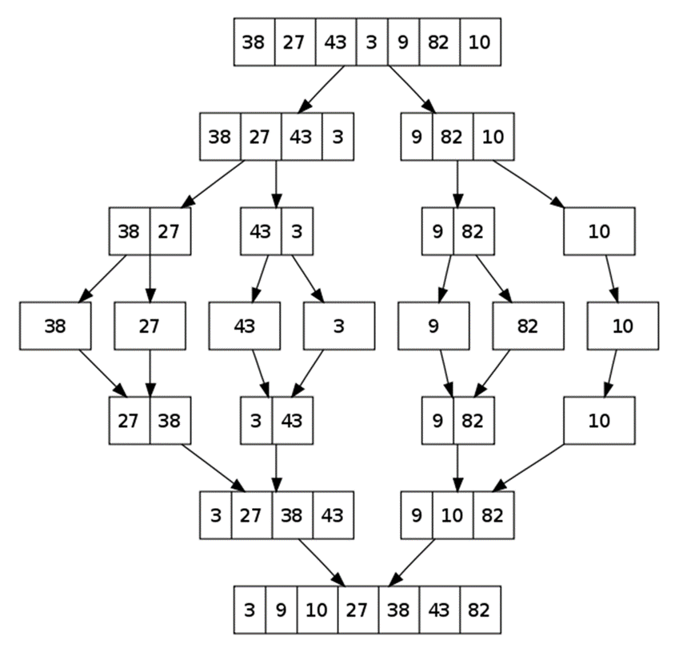
Merge Sort: Conceptual Overview

Slide 79
Merge Sort (1)
// Memory: O(n*log(n))
public static int[] MergeSort(int[] array)
{
if (array.Length == 1)
return array;
var middleIdx = array.Length / 2;
var leftHalf = array.Take(middleIdx).ToArray();
var rightHalf = array.Skip(middleIdx).ToArray();
return MergeArrays(MergeSort(leftHalf), MergeSort(rightHalf));
}

Slide 80
Merge Sort (2)
public static int[] MergeArrays(int[] left, int[] right) {
var sorted = new int[left.Length + right.Length];
var sortedIdx = 0; var leftIdx = 0; var rightIdx = 0;
while (leftIdx < left.Length && rightIdx < right.Length) {
if (left[leftIdx] < right[rightIdx]) {
sorted[sortedIdx++] = left[leftIdx++];
} else {
sorted[sortedIdx++] = right[rightIdx++];
}
}
// TODO: Take remaining elements either from the left or right
return sorted;
}

Slide 81
Merge Sort (3)
while (leftIdx < left.Length) {
sorted[sortedIdx] = left[leftIdx];
sortedIdx += 1;
leftIdx += 1;
}
while (rightIdx < right.Length) {
sorted[sortedIdx] = right[rightIdx];
sortedIdx += 1;
rightIdx += 1;
}

Slide 82
Merge Sort
// Memory: O(n)
public static int[] MergeSort(int[] array)
{
if (array.Length <= 1)
return array;
var copy = new int[array.Length];
Array.Copy(array, copy, array.Length);
MergeSortHelper(array, copy, 0, array.Length - 1);
return array;
}

Slide 83
Merge Sort (2)
public static void MergeSortHelper(
int[] source, int[] copy, int leftIdx, int rightIdx)
{
if (leftIdx >= rightIdx)
return;
var middleIdx = (leftIdx + rightIdx) / 2;
MergeSortHelper(copy, source, leftIdx, middleIdx);
MergeSortHelper(copy, source, middleIdx + 1, rightIdx);
MergeArrays(source, copy, leftIdx, middleIdx, rightIdx);
}

Slide 84
Merge Sort (3)
public static void MergeArrays(
int[] source, int[] copy, int startIdx, int middleIdx, int endIdx) {
var sourceIdx = startIdx;
var leftIdx = startIdx; var rightIdx = middleIdx + 1;
while (leftIdx <= middleIdx && rightIdx <= endIdx) {
if (copy[leftIdx] < copy[rightIdx])
source[sourceIdx++] = copy[leftIdx++];
else
source[sourceIdx++] = copy[rightIdx++];
}
// TODO: Take remaining elements either from the left or right
}

Slide 85
Merge Sort (4)
while (leftIdx <= middleIdx)
{
source[sourceIdx] = copy[leftIdx];
leftIdx += 1;
sourceIdx += 1;
}
while (rightIdx <= endIdx)
{
source[sourceIdx] = copy[rightIdx];
rightIdx += 1;
sourceIdx += 1;
}

Slide 86
Comparison of Sorting Algorithms
Name | Best | Average | Worst | Memory | Stable | Method
Selection | n² | n² | n² | 1 | No | Selection
Bubble | n | n² | n² | 1 | Yes | Exchanging
Insertion | n | n² | n² | 1 | Yes | Insertion
Quick | n * log(n) | n * log(n) | n² | 1 | Depends | Partitioning
Merge | n * log(n) | n * log(n) | n * log(n) | 1 | Yes | Merging

Slide 87

Greedy Algorithms
Picking Locally Optimal Solution

Slide 88
Greedy Algorithms
Used for solving optimization problems
Usually more efficient than the other algorithms
Can produce a non-optimal (incorrect) result
Pick the best local solution
The optimum for a current position and point of view
Greedy algorithms assume that always choosing a local optimum leads to the global optimum

Slide 89
Optimization Problems
Finding the best solution from all possible solutions
Examples:
Find the shortest path from Sofia to Varna
Find the maximum increasing subsequence
Find the shortest route that visits each city and returns to the origin city

Slide 90
Problem: Sum of Coins
Write a program, which gathers a sum of money, using the least possible number of coins
Consider the US currency coins
0.01, 0.02, 0.05, 0.10
Greedy algorithm for "Sum of Coins":
Take the largest coin while possible
Then take the second largest
Etc.
1$
1¢
50¢
5¢
25¢
4¢

Slide 91
Sum of Coins Visualization
Target: 18
10¢
5¢
2¢
1¢
10¢
5¢
2¢
1¢
Actual:
0

Slide 92
Sum of Coins Visualization
Target: 18
10¢
5¢
2¢
1¢
5¢
2¢
1¢
Actual:
10
10¢

Slide 93
Sum of Coins Visualization
Target: 18
10¢
5¢
2¢
1¢
2¢
1¢
Actual:
15
10¢
5¢

Slide 94
Sum of Coins Visualization
Target: 18
10¢
5¢
2¢
1¢
1¢
Actual:
17
10¢
5¢
2¢

Slide 95

Sum of Coins Visualization
Target: 18
10¢
5¢
2¢
1¢
Actual:
18
10¢
5¢
2¢
1¢

Slide 96
Solution: Sum of Coins (1)
var coins = // Read an array of integers and sort it in desc.
var target = int.Parse(Console.ReadLine());
var counter = 0;
var coinsIndex = 0;
var sb = new StringBuilder();
while (target > 0 && coinsIndex < coins.Length) {
var currentCoin = coins[coinsIndex++];
var coinsCount = target / currentCoin;
if (coinsCount > 0) {
counter += coinsCount;
target -= currentCoin * coinsCount;
sb.AppendLine($"{coinsCount} coin(s) with value {currentCoin}");
}
}
// TODO: Print the output

Slide 97
Problem: Set Cover
Write a program that finds the smallest subset of S, the union of which = U (if it exists)
You will be given a set of integers U called "the Universe"
And a set S of n integer sets whose union = U
1, 2, 3, 4, 5
4
1
2, 4
5
3
Sets to take (4):
2, 4
1
5
3

Slide 98
Solution: Set Cover
// Read the input elements – universe and sets
var selectedSets = new List<int[]>();
while (universe.Count > 0) {
var currentSet = sets
.OrderByDescending(s => s.Count(e => universe.Contains(e)))
.FirstOrDefault();
foreach (var number in currentSet)
{ universe.Remove(number); }
sets.Remove(currentSet);
selectedSets.Add(currentSet);
}
// TODO: Pirnt the output

Slide 99


Greedy Failure Cases
Greedy Algorithms Often Fail

Slide 100
Sum of Coins Failure
Target: 18
10¢
5¢
4¢
1¢
10¢
5¢
4¢
1¢
10¢
5¢
4¢
1¢
Actual:
0

Slide 101
Sum of Coins Failure
Target: 18
10¢
5¢
4¢
1¢
10¢
5¢
4¢
1¢
5¢
4¢
1¢
Actual:
10
10¢

Slide 102
Sum of Coins Failure
Target: 18
10¢
5¢
4¢
1¢
10¢
5¢
4¢
1¢
4¢
1¢
Actual:
15
10¢
5¢

Slide 103
Sum of Coins Failure
Target: 18
10¢
5¢
4¢
1¢
10¢
5¢
4¢
1¢
4¢
Actual:
16
10¢
5¢
1¢

Slide 104
Sum of Coins Failure
Target: 18
10¢
5¢
4¢
1¢
10¢
5¢
4¢
4¢
Actual:
17
10¢
5¢
1¢
1¢

Slide 105
Sum of Coins Failure
Target: 18
10¢
5¢
4¢
10¢
5¢
4¢
4¢
Actual:
18
10¢
5¢
1¢
1¢
1¢

Slide 106

Sum of Coins Failure
Target: 18
10¢
5¢
1¢
1¢
1¢
10¢
4¢
4¢

Slide 107

Optimal Greedy Algorithms
Optimal Substructure and Greedy Choice Property

Slide 108
Optimal Greedy Algorithms
Suitable problems for greedy algorithms have these properties:
Greedy choice property
Optimal substructure
Any problem having the above properties is guaranteed to have an optimal greedy solution

Slide 109
Greedy Choice Property
Greedy choice property
A global optimal solution can be obtained by greedily selecting a locally optimal choice
Sub-problems that arise are solved by consequent greedy choices
Enforced by optimal substructure

Slide 110
Optimal Substructure Property
Optimal substructure property
After each greedy choice the problem remains an optimization problem of the same form as the original problem
An optimal global solution contains the optimal solutions of all its sub-problems

Slide 111

Greedy Algorithms: Example
The "Max Coins" game
You are given a set of coins
You play against another player, alternating turns
Per each turn, you can take up to three coins
Your goal is to have as many coins as possible at the end

Slide 112
Max Coins – Greedy Algorithm
A simple greedy strategy exists for the "Max Coins" game
Always choose the local maximum (at each step)
You don't consider what the other player does
You don't consider your actions' consequences
The greedy algorithm works optimally here
It takes as many coins as possible
At each turn take the maximum number of coins

Slide 113

Summary
Searching algorithms
Binary Search, Linear Search
Slow sorting algorithms:
Selection sort, Bubble sort, Insertion sort
Fast sorting algorithms:
Quick sort, Merge sort, etc.
How to choose the most appropriate algorithm?
Greedy Algorithms
Notes:
113

Slide 114
Questions?
Notes:
114

Slide 115












SoftUni Diamond Partners

Slide 116


Educational Partners

Slide 117

License
This course (slides, examples, demos, exercises, homework, documents, videos and other assets) is copyrighted content
Unauthorized copy, reproduction or use is illegal
© SoftUni – https://about.softuni.bg/
© Software University – https://softuni.bg
Notes:
117

Slide 118
Trainings @ Software University (SoftUni)
Software University – High-Quality Education, Profession and Job for Software Developers
softuni.bg, about.softuni.bg
Software University Foundation
softuni.foundation
Software University @ Facebook
facebook.com/SoftwareUniversity
Software University Forums
forum.softuni.bg
Notes:
118

